Slide 1
Jasmine Testing to the Rescue!
Presented by Chris Steele
Notes:
Thank you for joining my talk and thank you to the organizers and speaker reviewers

Slide 2

About Me
Chris Steele – Director of Consulting
Bio
From Lewis Center, OH
Married with 4 kids
Full-Stack Developer (.NET)
9 years of industry experience
Bachelors in Computer Information Systems at DeVry University
Masters in Information Systems Management at Keller Graduate
Notes:
Don’t forget to talk about passions and my goals for today

Slide 3
Level-Set Expectations

Slide 4
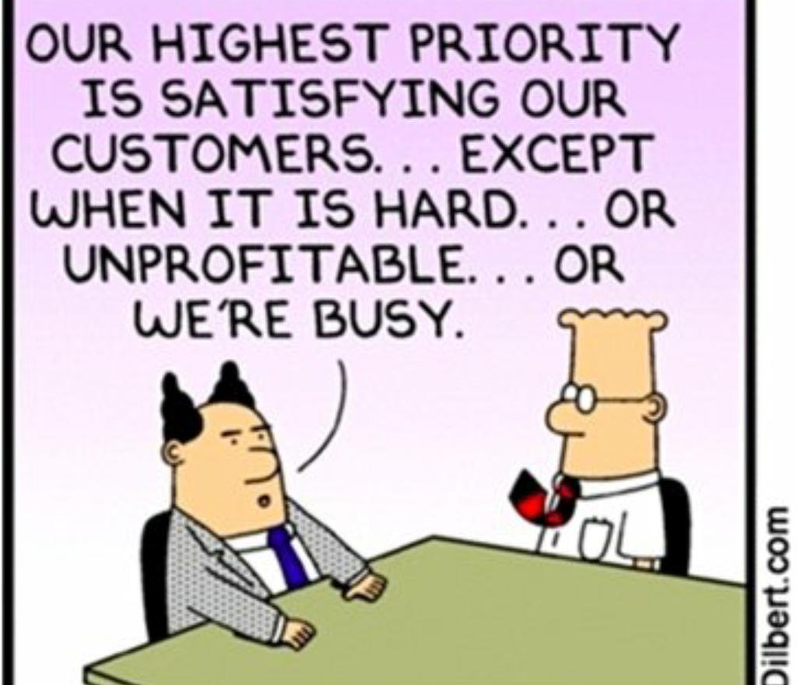
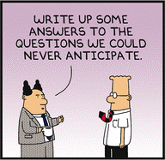
What Should You Expect?
What should you expect?
Walk away with an understanding of how easy it is to get started with Jasmine
An urge to get started
What should you not expect?
Learn Test Driven Development (TDD) practices
Development best practices
Notes:
Show of hands new to Jasmine
Show of hands new to JavaScript testing

Slide 5
So Who Is Jasmine?

Slide 6

Jasmine is…
A behavior driven JavaScript testing framework that does not rely on browsers, DOM, or any JavaScript Framework.
Works anywhere JavaScript can be run (i.e., websites and Node.js projects)

Slide 7

…And I Care Why?
It has roots
Been around for 9+ years
Still very popular and well supported
Everything in one package
Setup with NPM, Gulp, Ruby Gem, and Python Egg
Also includes a standalone installation
No external dependencies
But plugins exist

Slide 8
How Do I Get Started

Slide 9
Jasmine Standalone Installation
Download the zip
https://github.com/jasmine/jasmine/releases
Unzip the files into your solution
Move the unzipped files/folders into the appropriate folders within your project
lib = jasmine framework
spec = example test scripts
src = example JavaScript files
Update the references within the SpecRunner.html if necessary
Open the SpecRunner.html
Notes:
Show package contents

Slide 10
Demo

Slide 11
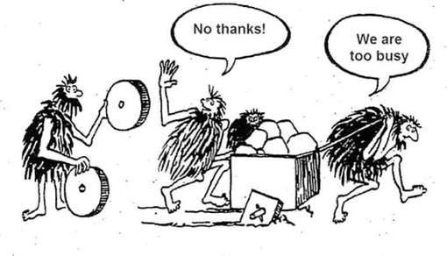
But first, let’s do a scenario!
You’ve been supporting a web-based application for some time
There have been more bugs than normal from recent releases and your team is looking for ways to improve
After research, your team has come to the conclusion that we need to start writing JavaScript unit tests
You now have been asked to add unit tests using Jasmine

Slide 12
What Else Can It Do?

Slide 13

That was great! Is there more??
Jasmine can also mock
setTimeout and setInterval
Dates
Jasmine supports asynchronous operations
Callbacks
Promises
Async/Await
Jasmine can create custom:
Reporters
Matchers
And much more!

Slide 14
Let’s sum this up!

Slide 15

What just happened?
Behavior-driven JavaScript testing framework
Easy setup with common package managers as well as a standalone installer
It has roots – 9+ years
Fast, all-inclusive, and no external dependencies
Time to check it out for yourself!

Slide 16
Resources

Slide 17

Show me the sources!
Presentation sources
Code: https://github.com/csteele86/ko-calculator
Presentation: http://bit.ly/MomentumJasmineTestingPresentation
Jasmine
Standalone installation: https://github.com/jasmine/jasmine/tree/master
Setup with Node.js: https://jasmine.github.io/setup/nodejs.html
Documentation: https://jasmine.github.io/pages/docs_home.html
Further learning
Using Karma Runner
Installation: https://karma-runner.github.io/latest/intro/installation.html
Setup: https://karma-runner.github.io/latest/intro/configuration.html

Slide 18



Chris Steele – Director of Consulting chris.steele@improving.com | csteele86@gmail.com
Presentation: http://bit.ly/MomentumJasmineTestingPresentation
@csteele86 | @csteele86 | @christopherbsteele

